Slide 1

Bank Loan Deep Learning model
OESON Final Project

Slide 2

Project Task
Data: We are given real data in a Loan Dataset sourced from a Bank Data Site consisting of Loan Records, containing sensitive information about all the loan applicants for Bank XYZ.
Goal: Our main goal is to prepare a deep learning model which will be employed to identify prospective defaulters, performing Financial Fraud Detection.

Slide 3
Project Methodology
Data Loading: Being provided with Testing and Training data separately, we load these into respective Pandas Data-Frames separately.
Data Cleaning: Apply a Data Inspection Function to check for null values and duplicate values then replace them.
Data Pre-Processing: We remove all columns which have no correlation to our loss Target variable, standardise all the columns, however we do not remove outliers in this case because they are needed within fraud detection.
Data Subsets: Since the training and testing data is too big on a whole to train this model within Google Colab, we take a subsets of this data.
Train-Val-Test Split: We split the initial Training Data into train, validation, test datasets via the ratio 60:20:20 respectively. Also we take a subset of the initial Testing Data labelled as “test_data_prediction” used to make our final model predictions.
Deep Learning Models: TensorFlow Neural Network and LSTM (Long-Short Term Memory Network Models)
Training: We train our models on the training subset, setting our optimiser to be Adam and our loss function to be MSE (Mean Squared Error), and compare their training and validation loss.
Optimisation: We optimise our models on our validation subset, choosing our optimal hyper-parameters for our final models
Testing and Evaluation: We evaluate our models on our testing data subset, before making a choice on the Final Model to our solution
Prediction: We make predictions using our Testing Data subset to visualise how our models will work and analyse the predictions
Saving: Lastly, we save our models.

Slide 4
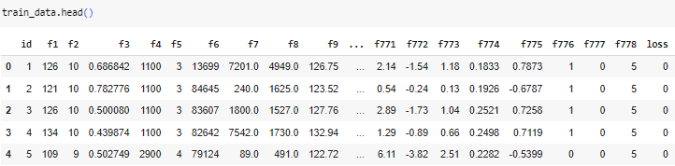
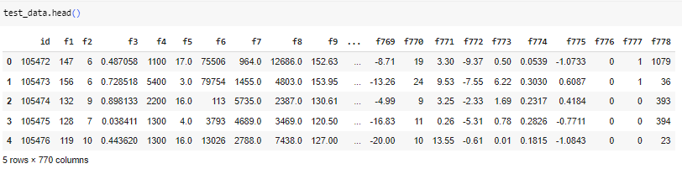
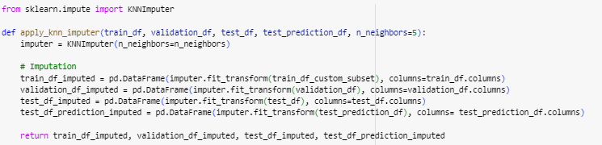
Data preparation – Inspection/ Cleaning
Inspection: Training Data consists of 105, 471 rows and 771 columns , and our Testing Data has 210, 944 rows and 770 columns. Every single feature is numeric.
Cleaning – Null Value Imputation: There are no duplicate values, however we use a KNN Imputer to replace the null values in the subsets.

Slide 5
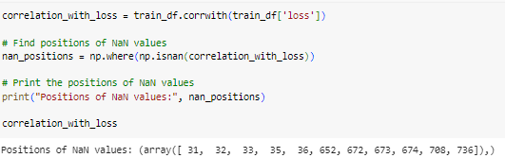
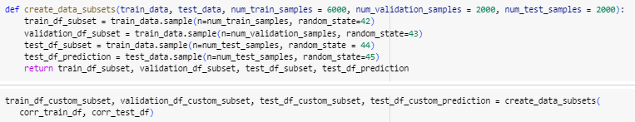
Data preparation – Feature Selection/ Sub-Sets/ Pre-Processing
Correlation Analysis: We remove the features within the correlation analysis that have no correlation to the target loss variable (0) since these are irrelevant features.
Subsets, Train/Val/Test: Since the size of both datasets is enormous, having 210,944 rows and 759 columns after feature removal, we split this into subsets. The training data is split into a ratio 60:20:20 in accordance to a train/val/test split.
We then take a subset of the same size as the validation and test subsets for our prediction but from the testing data.

Slide 6
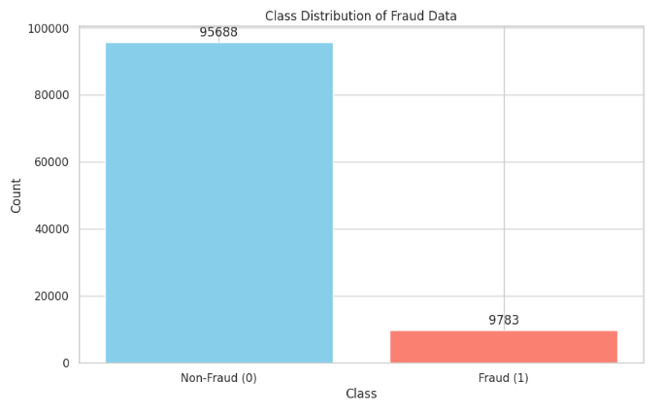
EDA
In our data set we have a loss column, which we predict and is our target variable and has a range from 0-100. Due to limited knowledge on our dataset, and a high proportion of values being 0, we simplify our problem down to this.
If the loss value is greater than 0, then we investigate this loan applicant for fraud.
After Feature Creation, we can see the statistics of loan applicant defaulters in the following bar chart.

Slide 7
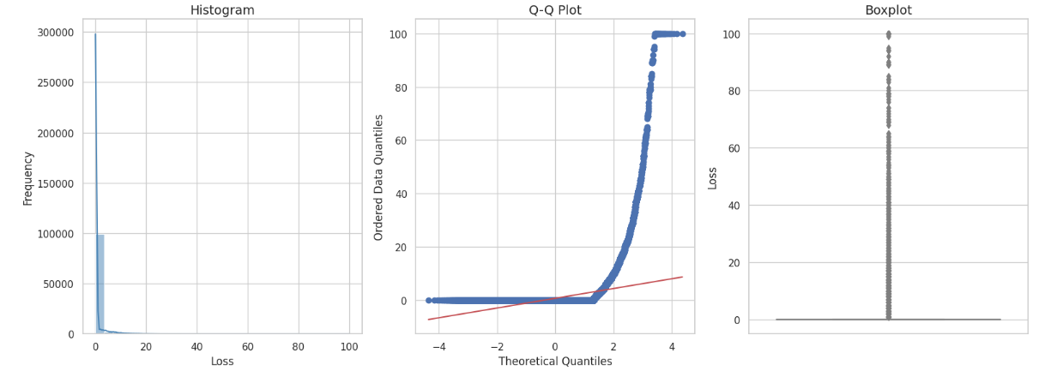
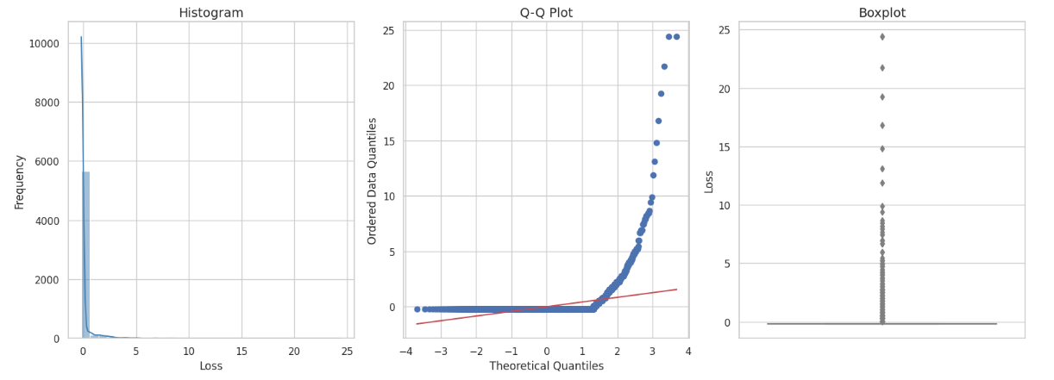
Standardisation of Loss
As you can see our loss Target Variable is heavily skewed, and there are a significant number of outliers.
We standardise our Target Loss Variable reducing the skewness and the number of outliers.

Slide 8
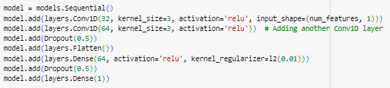
Fully Connected neural Network
Initial NN Model Trials
After splitting the data, standardising all columns using a Standard Scaler (best considering there are positive and negative values) and then reshaping the datasets into NumPy arrays with shape (x, y, 1) so they can be used with the TensorFlow Neural Network, We trialled our models with basic NN architectures, only 3 layers at first, getting very high losses. To reduce this, we added:
Dropout Layers: We have a probability p = 0.5, with 500 neurons being dropped at every iteration, with all forward and backward connections with a dropped node being temporarily removed, to prevent the model from overfitting.
L2 Regularisation: There are two types of regularisations, L1 and L2. L2, Ridge Regression is used to address collinearity between independent variables discouraging the model from fitting the noise in the data.
Early Stopping: This stops the model from running midway through its epochs once the loss starts to increase again due to overfitting the data.
Penultimate Model Trial
Consisting of two convolutional 1D layers, two dropout layers, 2 dense layers and a flattened layer, we get our first feasible model. However, despite being set to run 20 epochs, we stop at 15, since the losses started to increase.

Slide 9
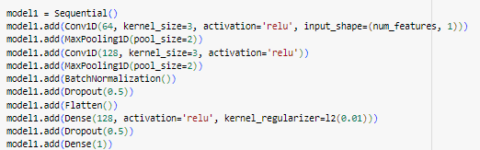
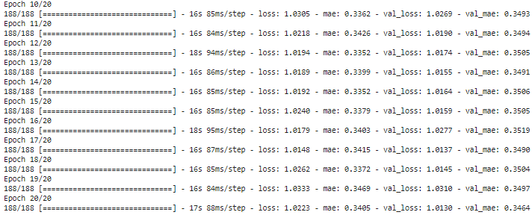
Fully Connected neural Network
Final Model Architecture
We increase the number of filters, and adding Max Pooling Layers and Batch Normalisation:
Max Pooling: Reducing the number of parameters and computations within the network, controlling overfitting. To the single channel as this is a 1D neural network, it applies a pooling region to divide the channel into non-overlapping regions and selects the maximum value within each region of the feature map.
Batch Normalisation: This is used to improve training stability and accelerate convergence, helping address the problem of internal covariate shift, stabilizing gradients, and acting as a form of regularisation. For each batch, it reduces the internal covariate shift by normalisation making it easier for the network to learn and converge faster.
Final Model Results (Last 10 Epochs)
After training our model, we have our final model accuracy of being 1.0223.

Slide 10
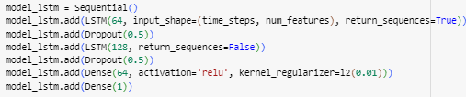
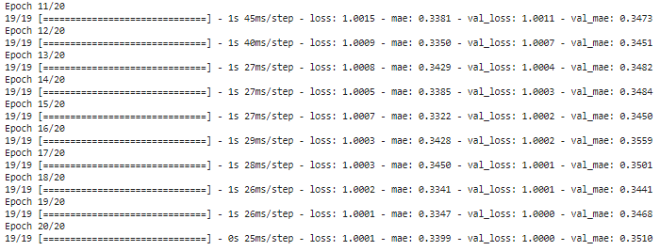
Long-Short Term neural Network
LSTM Architecture
LSTMs are a type of Recurrent Neural Network which is suited for Sequential Data due to their good memory of previous inputs, ability to handle variable-length sequences and robustness to vanishing/ exploding gradients. After reshaping the data, we train our LSTM model, achieving a final accuracy of 1.0001.
LSTM Results (Last 10 Epochs)

Slide 11
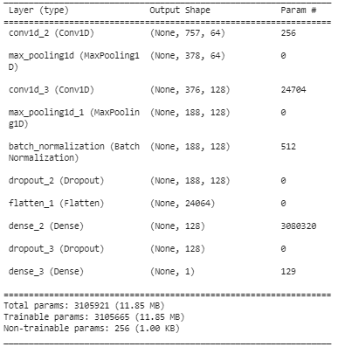
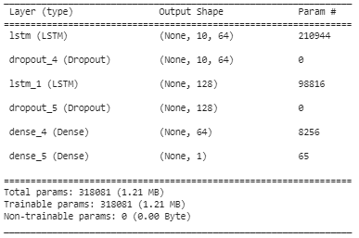
Model Summaries
Fully Connected NN Summary
LSTM Summary

Slide 12
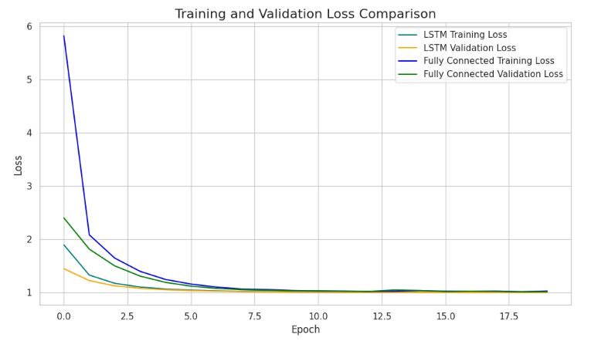
Training and Validation Losses of both models

Slide 13
Final Model Comparison and Evaluation
Neural Network | Loss | MAE
Fully Connected Neural Network | 1.014 | 0.395
LSTM | 1.000 | 0.390

Slide 14
Further Work
Testing More Batches: Since splitting the data only randomly taking 10000 rows from the 108,000 + training dataset and 2000 rows from the training dataset, we do not get accurate results on predictions of fraud. We have to run this model on multiple batches, recording results separately, or run these Neural Networks using GCP.
Pre-Trained Models: We can use State-of-the-Art models like Variational Encoders and Generative Adversial Networks which have proven to be effective in detecting credit card fraud detection.
Ensemble Methods: We can implement Ensemble Methods to combine the predictions of multiple models, improving accuracy further.
Other Archictures: We can explore the use GRU (Gated Recurrent Unit), CNN and RNN models in also handling this problem, to expand our comparison.

Slide 15
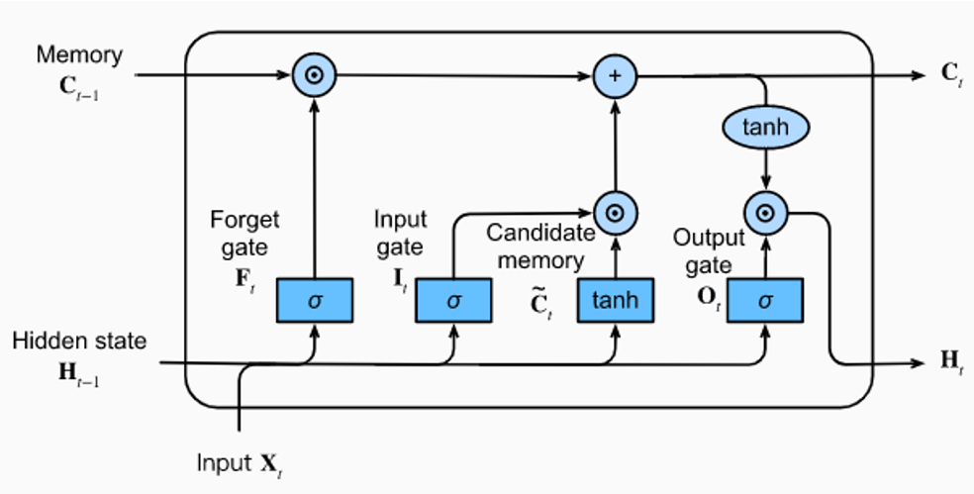
Conclusions
1) We find that for the Fully Connected NN Architecture, by increasing the number of filters to 256 after the Final Model, causes the model to overfit, and results in slightly higher losses than our Final Model.
2) The LSTM Model had a much simpler architecture with almost 10 times as less parameters as the Fully Connected Neural Network, yet it still had a higher accuracy and lower Mean Average Error Score.
3) Adding Batch Normalisation to the Fully Connected Neural Network and increasing the number of Filters significantly minimised losses and increased accuracy.

Slide 16

Thank you
Rohit Sunku

